Slide 1
Splunk
By Puspa Khanal

Slide 2
Agenda
Why Splunk? – Problems With Log Data
What is Splunk? – Ultimate Soln. For Log Processing
How Does it Work? – Splunk Components
Hand-On: - Log Collection & Analysis

Slide 3
What is Splunk:
Splunk is Log Analyzing and Monitoring tool which communicates with the different log files and stores file’s data in the form of events into local indexes.
Splunk has the capability to show data in different forms of dashboards which useful for the application users and higher leadership.
Splunk Features:
Reporting
Monitoring
Log Analysis
Dashboards

Slide 4
Different ways to use Splunk
Splunk Enterprise:
. Splunk Enterprise collects, analyze and act on the value for the data generated by technology infrastructure, security systems and business results.
Splunk Cloud:
. Splunk Cloud delivers all the features of Splunk Enterprise, as a cloud-based service. The platform provides access to Splunk enterprise Security and the Splunk App for AWS and enables centralized visibility across cloud, hybrid and on-premises environments.
-Splunk Lights:
. Splunk Light is a solution for small IT environments that automates log search and analysis. It speeds troubleshooting by gathering real-time log data form your distributed applications and infrastructure in one place to enable powerful searches, dynamic dashboards and alerts, reporting for real-time analysis-all at an attractive price that will fit in budget.

Slide 5
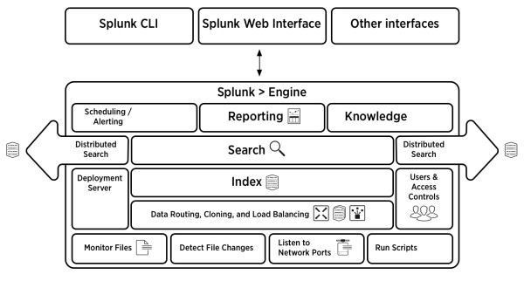
Splunk Architecture
Communicates with log files
Listen on network Ports
Run Scripts
Monitor Files
Searches the events

Slide 6
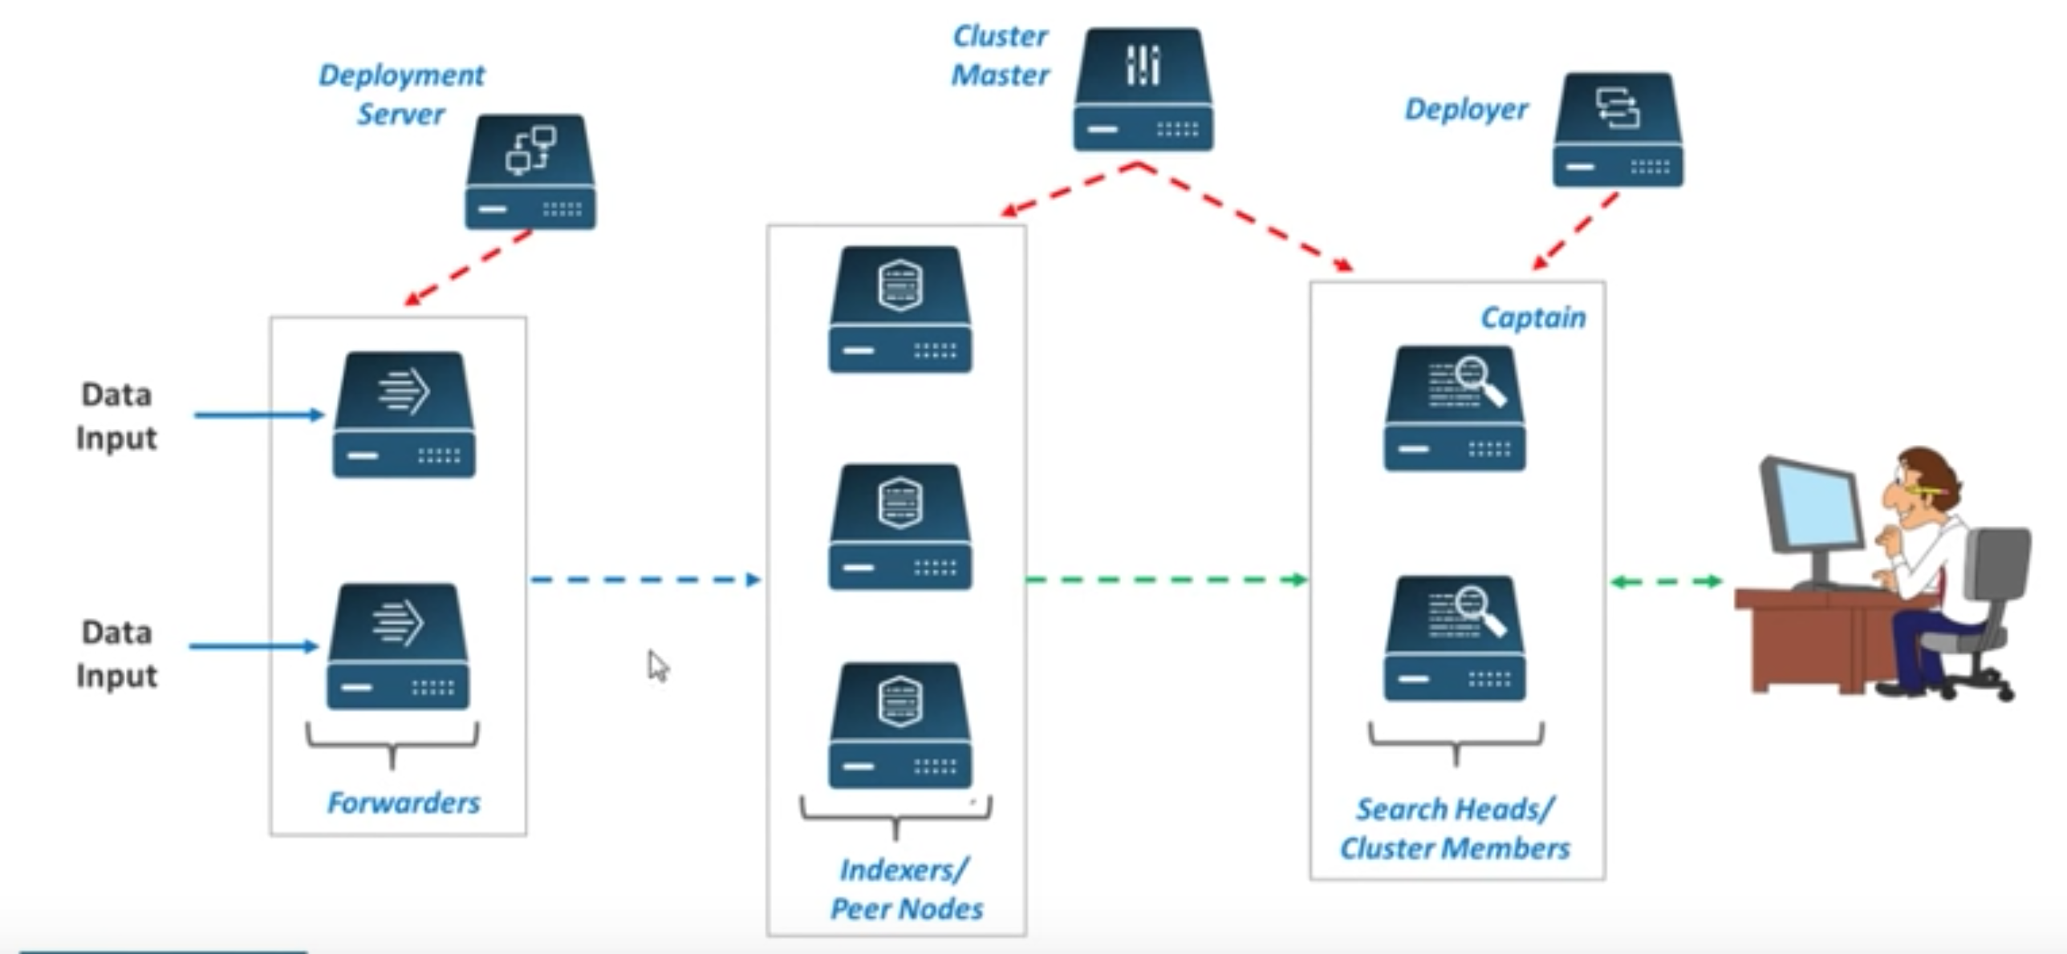
Splunk Components
Search Head
Indexers
Forwarders
Deployment Server

Slide 7
Let’s start by understanding why Explore Logs?

Slide 8

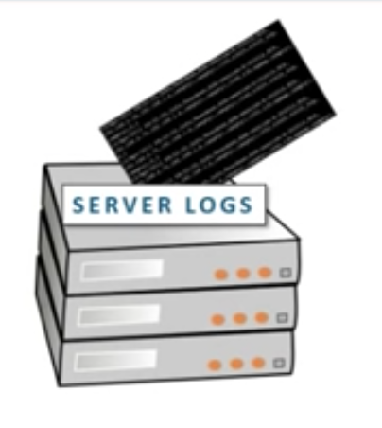
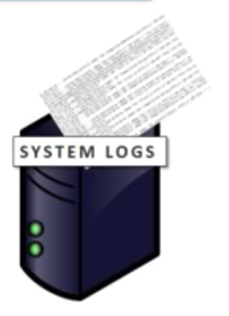
Why Explore Logs?
Logs are the go-to achieves for gaining company-wide Operational Intelligence.

Slide 9
Server logs
Source of IP traffic
Security threats
Network vulnerability
Network traffic & spike

Slide 10
System logs
System Performance
CPU usage & load
User access logs
App performance Monitoring

Slide 11
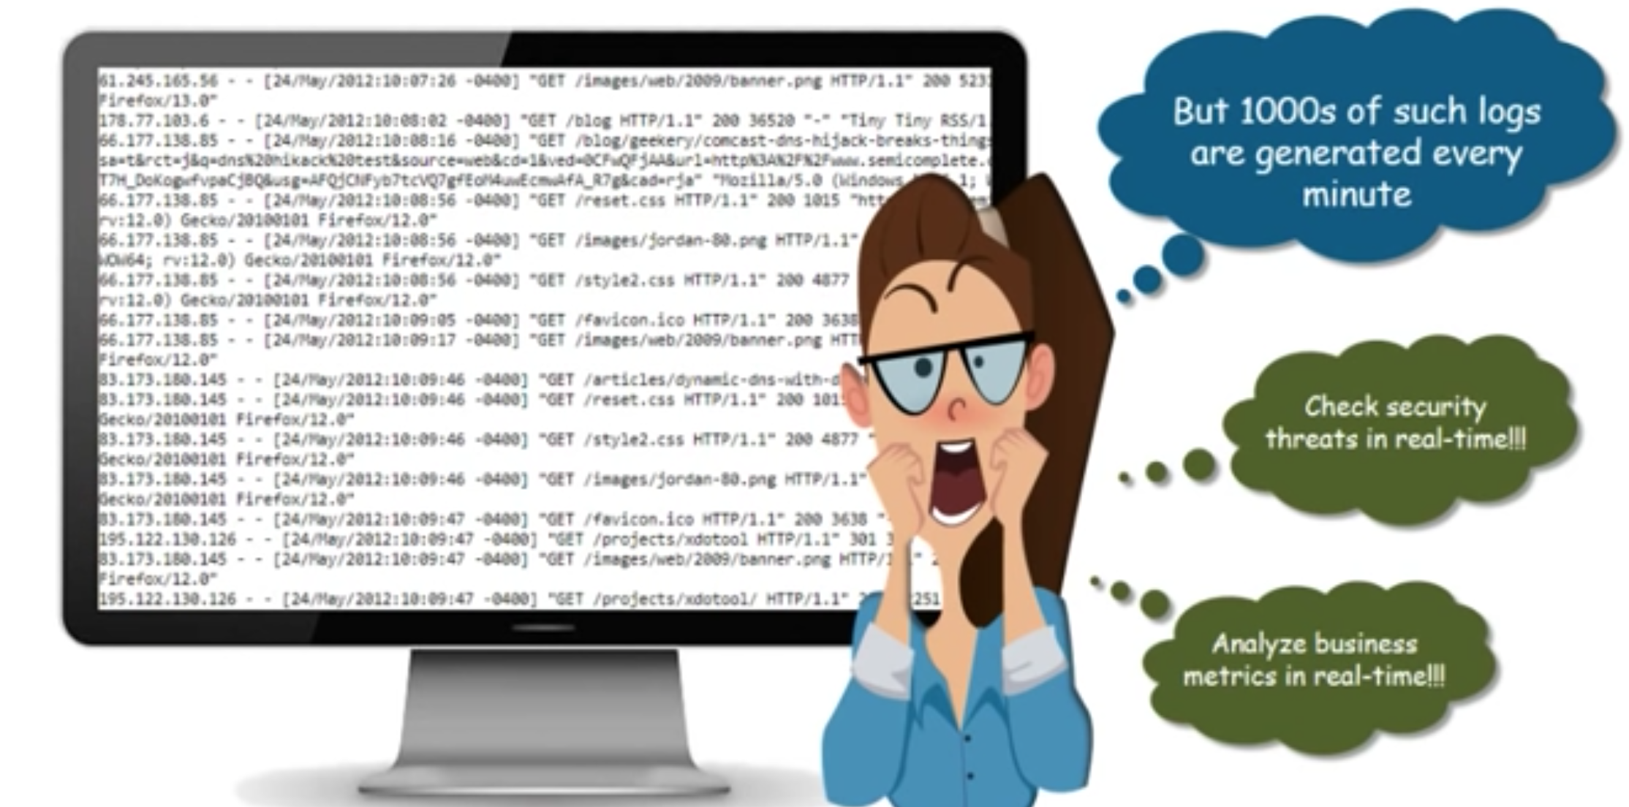
Exploring Logs & Challenges

Slide 12
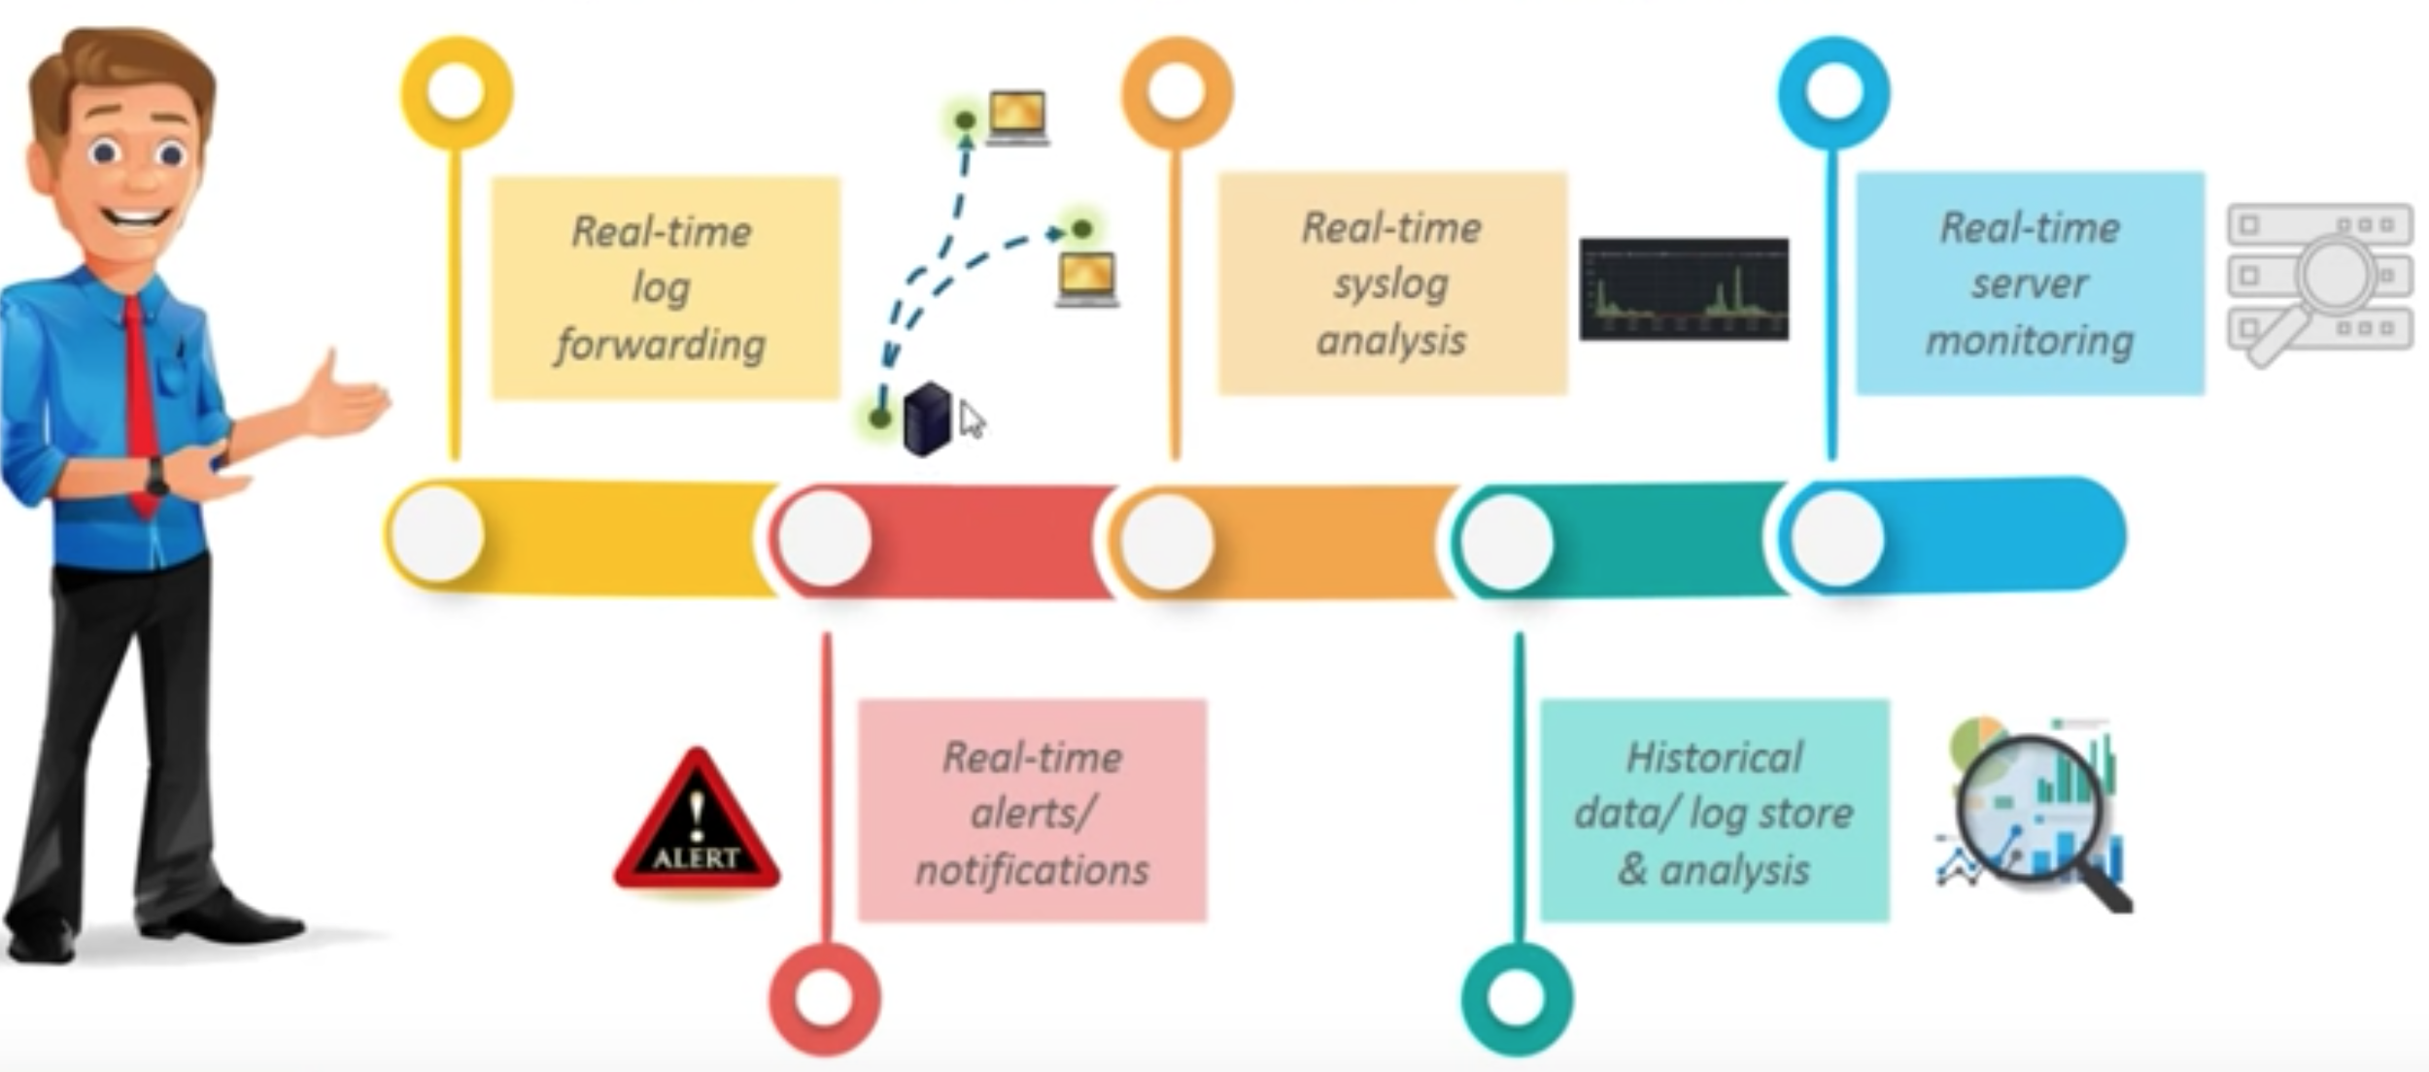
Exploring – solution – Splunk
Splunk is the ultimate log collection & analysis tool

Slide 13
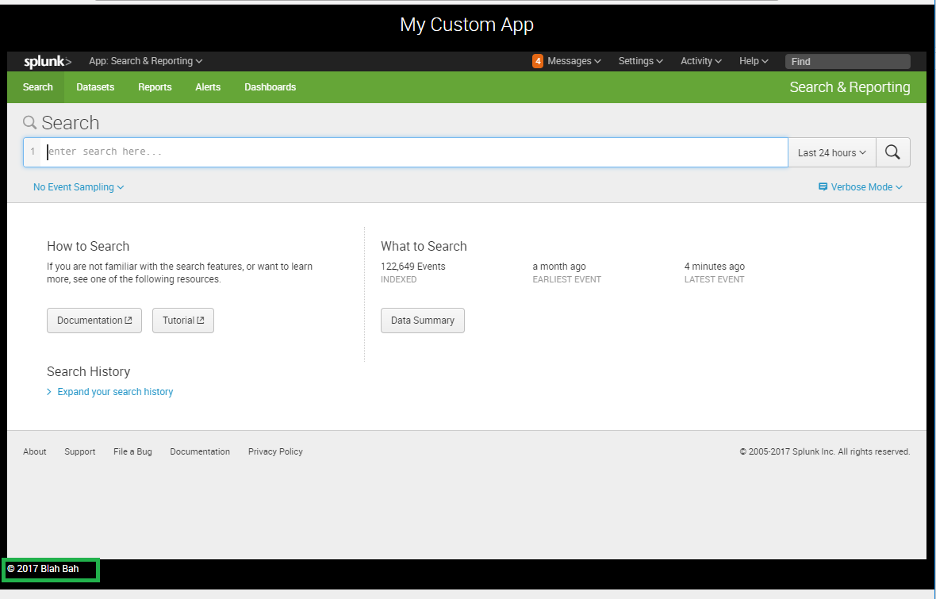
Splunk search head
Identify server for Search Head
Install Splunk on the Server
Setup Server as a Search Head
Distributed Search setup

Slide 14
Configure search peers
Configure Search peers
Setting – Distributed Search
Click on Search Peer
Click New Search peer
Add Details of the indexers

Slide 15
Splunk indexers
Identify server for indexer
Install Splunk on the server
Setup Server as an indexer

Slide 16
Configure Receiving
Settings – Forwarding and Receiving
Click on Configure Receiving
Click New
Add Port to receive events

Slide 17
Splunk Forwarders
Identify server for forwarding events
Install Splunk forwarder on the server
Setup Server as a Forwarder
Heavy and Universal forwarder
Download forwarder setup
Install forwarder on the machine to forward data

Slide 18
Splunk Licensing
License Master
License Slave
License Pool

Slide 19
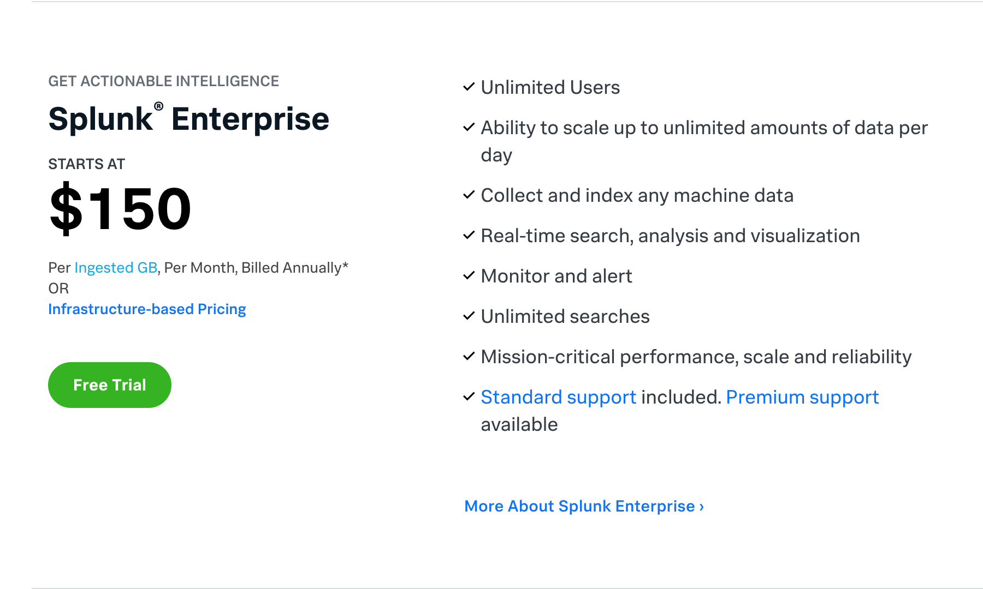
Splunk Enterprise

Slide 20
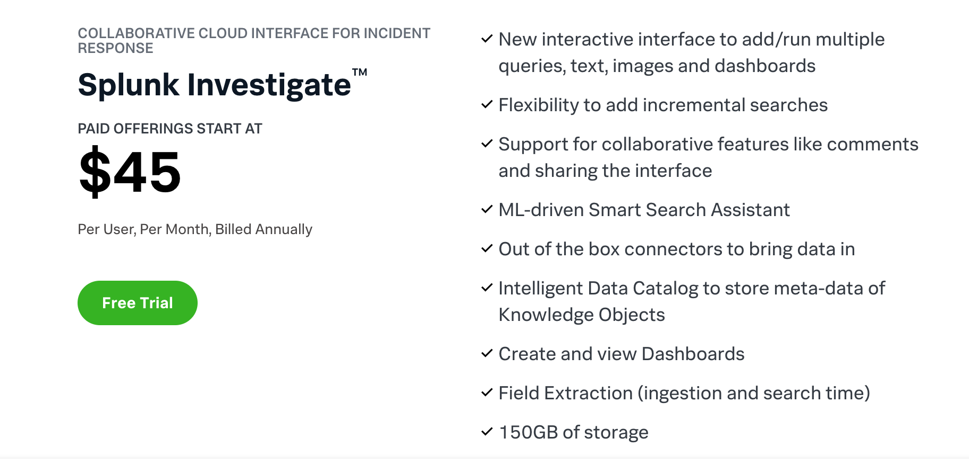
Splunk Investigate

Slide 21
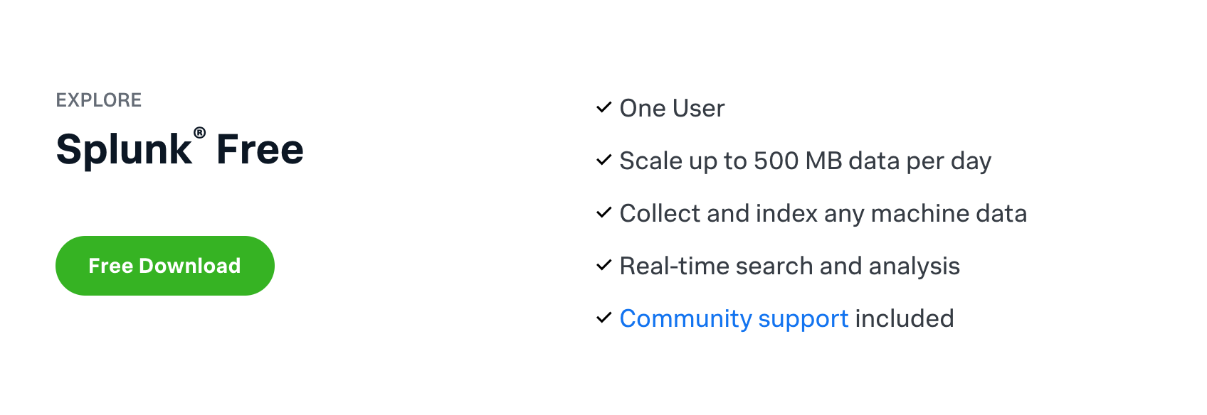
Splunk free

Slide 22
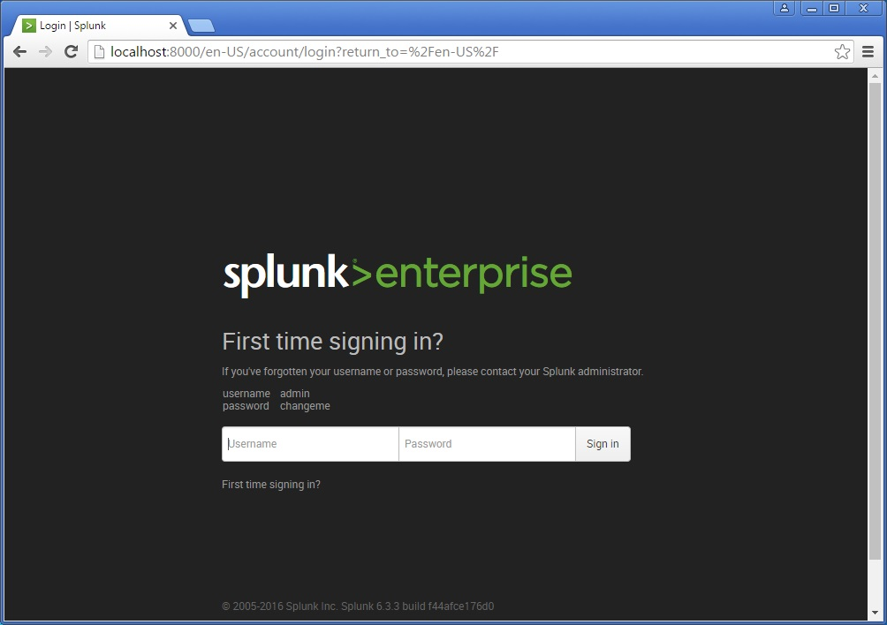
Download and configure Splunk
Splunk Setup can be downloaded form:
https://www.splunk.com/en_us/download.html
Free Trial Version For 60 Days
Run Spunk MSI file to install Splunk
Default location:
C:\program files\Splunk

Slide 23
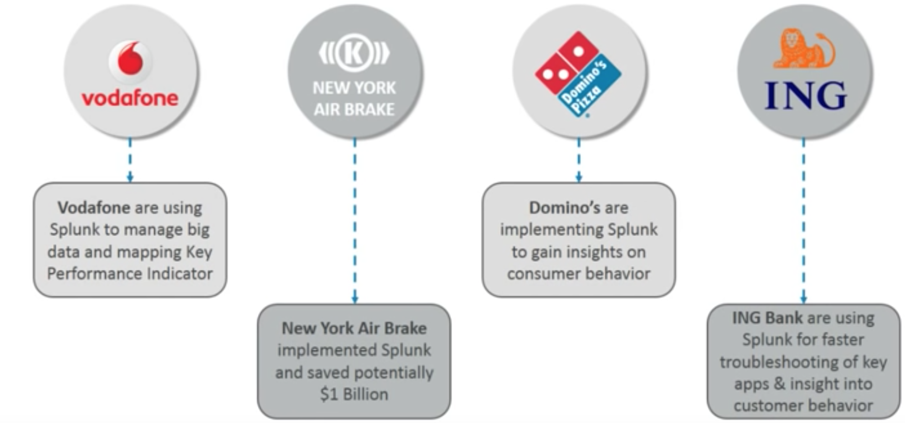
Splunk Customers & Use Cases

Slide 24
Question Time

